Slide 1

Introduction to Python
BIO334
Maria Heimlicher & Matteo Peluso & Tülay Karakulak
Christian von Mering group
maria.heimlicher@mls.uzh.ch
courtesy of Danaila, Sumner, Lyon, Tackmann, Dmitrijeva & Gable
https://github.com/meringlab/Bio334.git

Slide 2
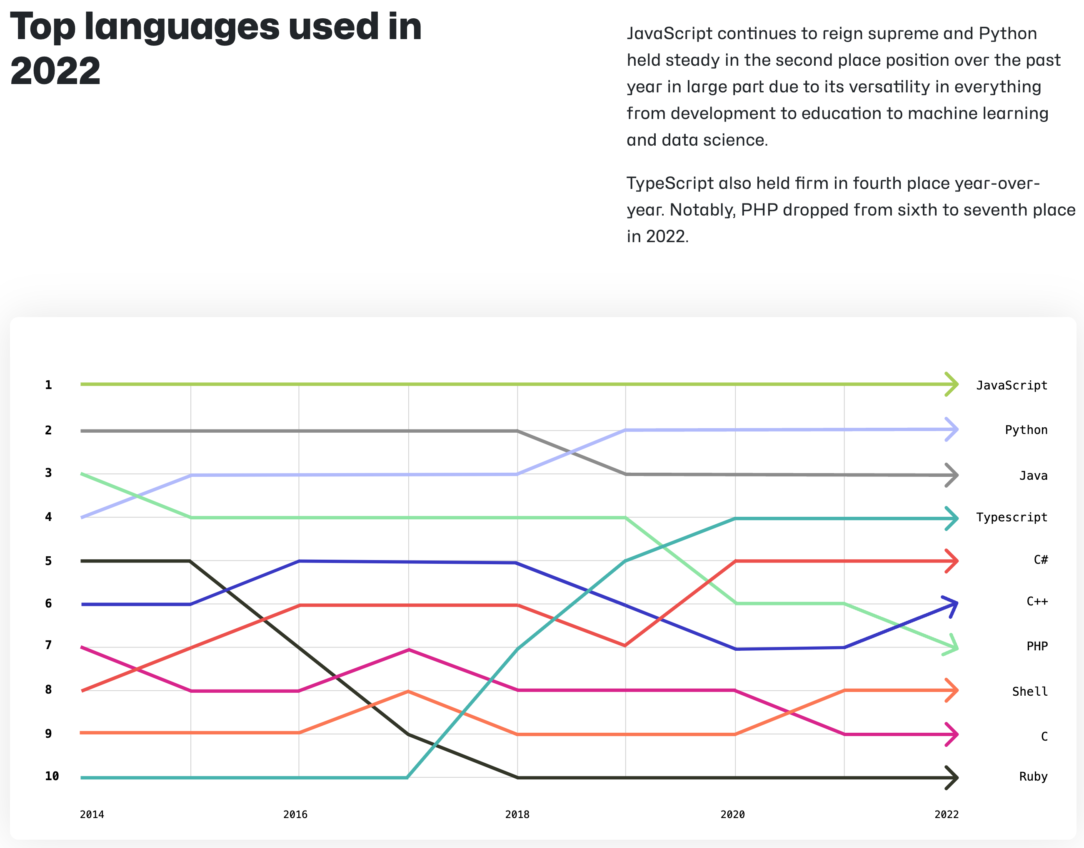
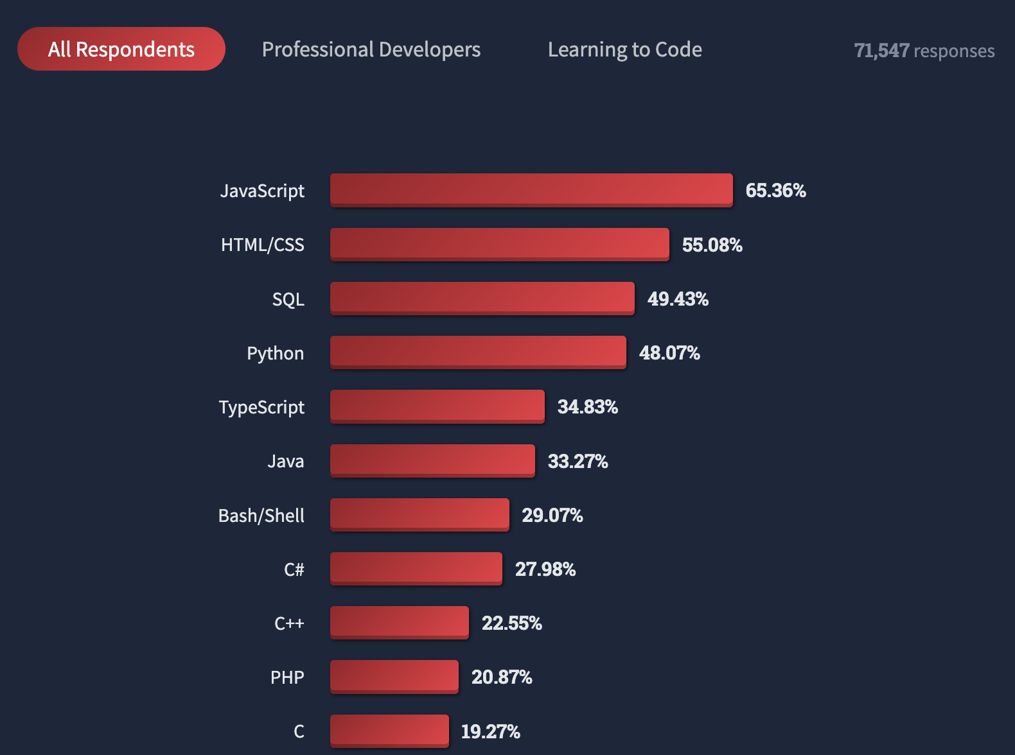
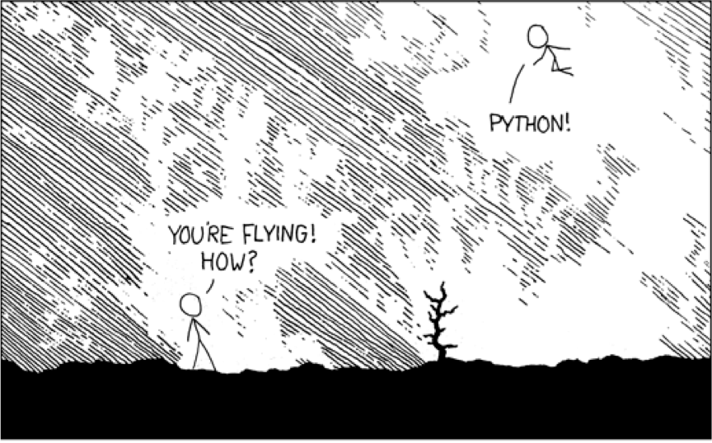
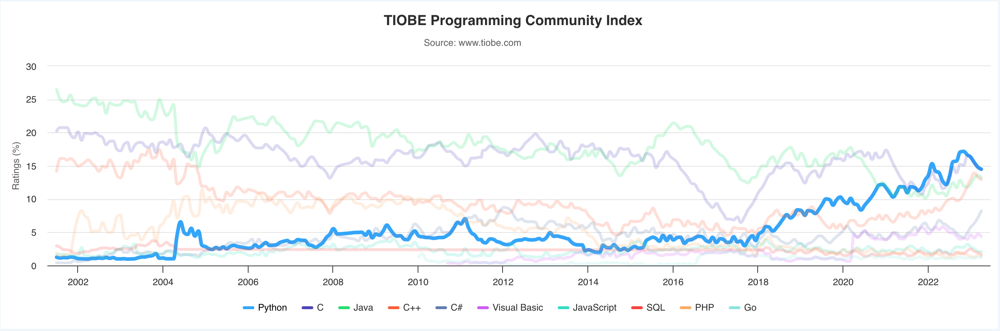
What is Python?
Dynamic, interpreted, open source programming language
Simple syntax with fast learning curve
Octoverse by Github: Top languages used in 2022
Stack Overflow 2022: most popular languages
TIOBE Programming Community Index

Slide 3
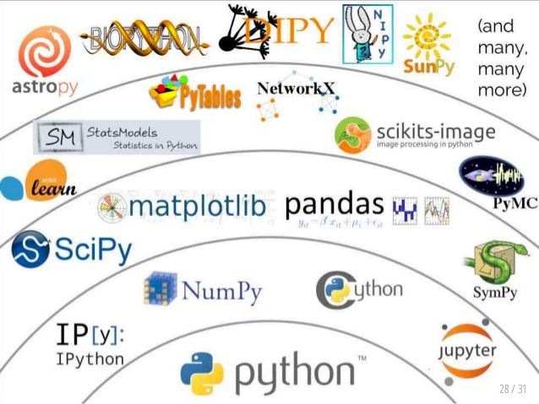
Scientific Python stack: more than core Python

Slide 4
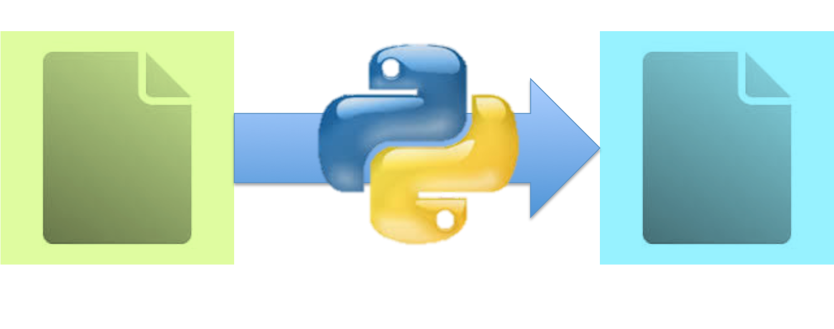
Today’s goals
get your hands dirty with the basics
simple statements, for loops, control flow
learn how to read a sequence file, extract useful information

Slide 5
Today’s program
Introduction to programming: refresh the basic concepts with small hands-on sessions in JupyterLab
Break
Writing Python code to solve Exercises 1 and 2 (and optional Exercises 3 and 4)
Optional: go through solutions of exercise 1 and 2 at 4pm

Slide 6
Part 1:
Programming basics

Slide 7
Variables
Store a piece of data and give it a specific name with the “=“ (equal) operator
a = 4
pi = 3.14159
my_string = "hello"
# single and double ticks are equal
# (just stick to one) ‘hello’ or “hello”
my_protein_sequence = 'MRHIAHTQRCLSRLTSLVALLLIVLP'
Basic rules for variable names:
NO spaces
don’t start with numbers
use descriptive names

Slide 8
Operators
Arithmetic operations
addition + , subtraction -
division /, multiplication *
exponent **
>>> 2 + 3
5
>>> 23 - 3
20
>>> 22.0 / 12
1.8333333333333333
>>> (1 + 2) * 3
Boolean operations
return True or False
comparison operators: == , > , <
logical operators: and, or, not
>>> 1 < 2
True
>>> 23 == 45
False
>>> 2<3 and 4!=3
True

Slide 9
Get ready for live sessions in JupyterLab: Download course files
open a Terminal window (e.g. Spotlight search: terminal):
change to your personal course folder (or where you would like the files to go)
cd /Volumes/Kurs/UsersBio/mheiml #replace with your shortname
clone the git repository by entering:
git clone https://github.com/meringlab/Bio334.git
checkout our course files under 02_python_introduction
next up: installation and short demo on how to use JupyterLab

Slide 10
Get ready for live sessions in JupyterLab: (Install and) launch JupyterLab
open a Terminal window and enter the following commands
cd /Volumes/Kurs/UsersBio/yourShortname
. /opt/miniconda3/etc/profile.d/conda.sh #space after dot matters!
conda create --prefix /Volumes/Kurs/UsersBio/yourShortname/py38_envs python=3.8 #copy whole line starting from conda
conda activate /Volumes/Kurs/UsersBio/yourShortname/py38_envs
conda install jupyter #press y and Enter when asked
jupyter lab #to open jupyter lab
first time: run all the commands, blue and yellow
after this: run only the blue commands to open JupyterLab again

Slide 11
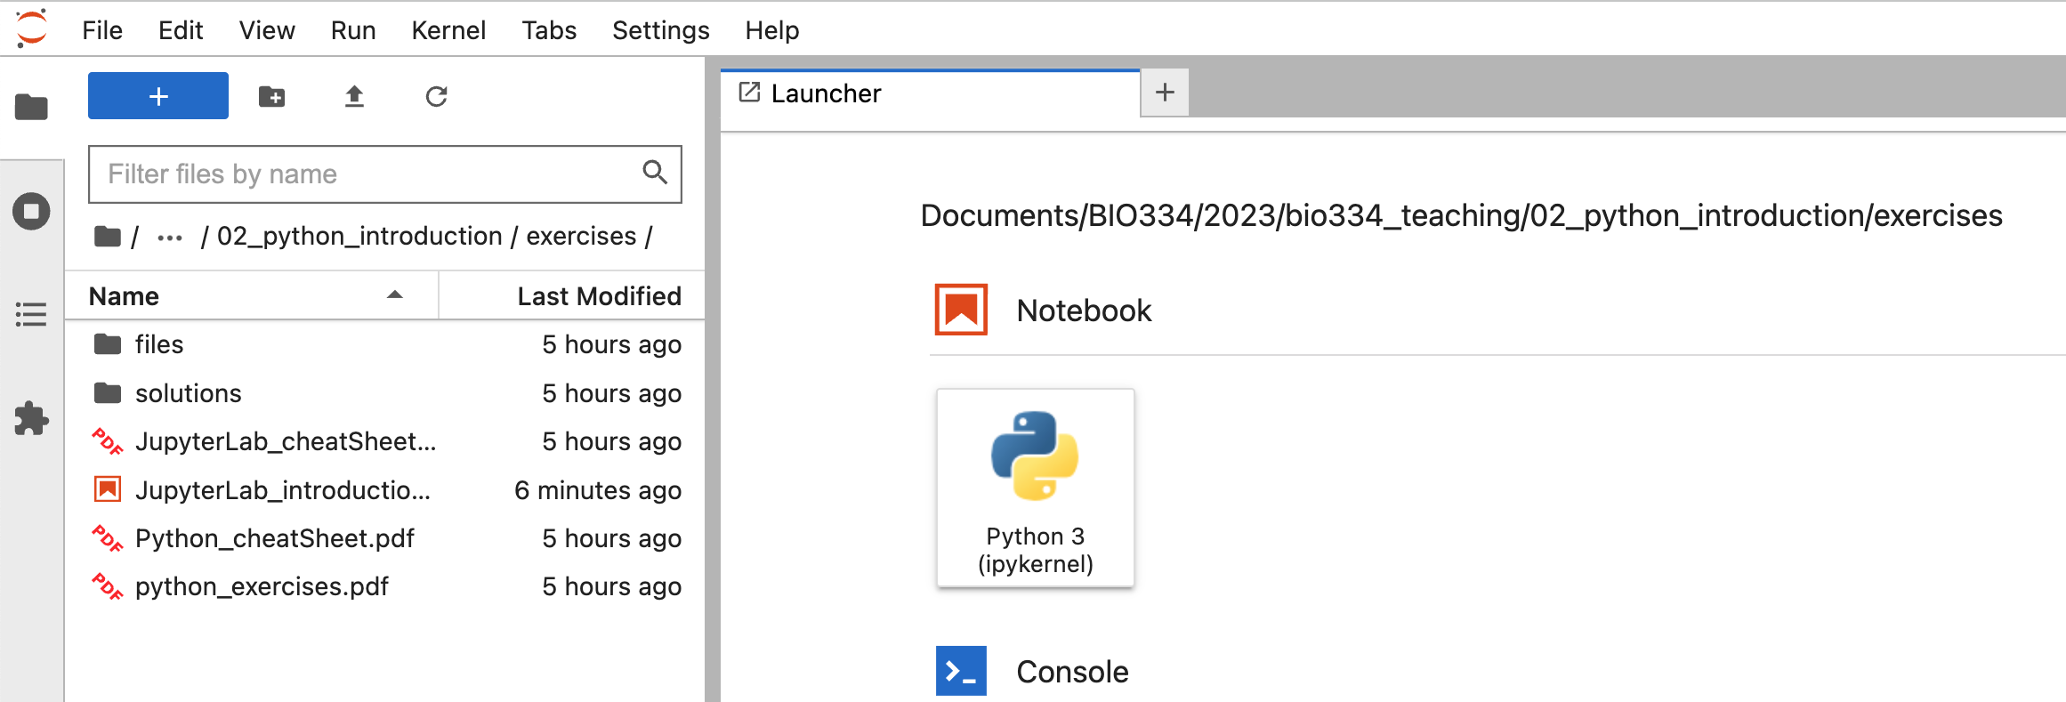
Get ready for live sessions in JupyterLab: start your first Jupyter Notebook
in Jupyter: go to Bio334/02_python_introduction/exercises
launch the Jupyter Notebook JupyterLab_introduction.ipynb for an interactive session

Slide 12
Session I: variables and basic operations
welcome_message = 'hello world!' # hit [shift + enter] after every line
welcome_message # more general alternative: print(welcome_message)
# Arithmetics: use python as your advanced calculator
a = 4
b = a + 3
(a + b) * 4
a / 8
a**2
# Let's try with strings
welcome_message + welcome_message
a = '4'
a + 3 # anything strange?
# whats the difference?
a + str(3)
int(a) + 3

Slide 13
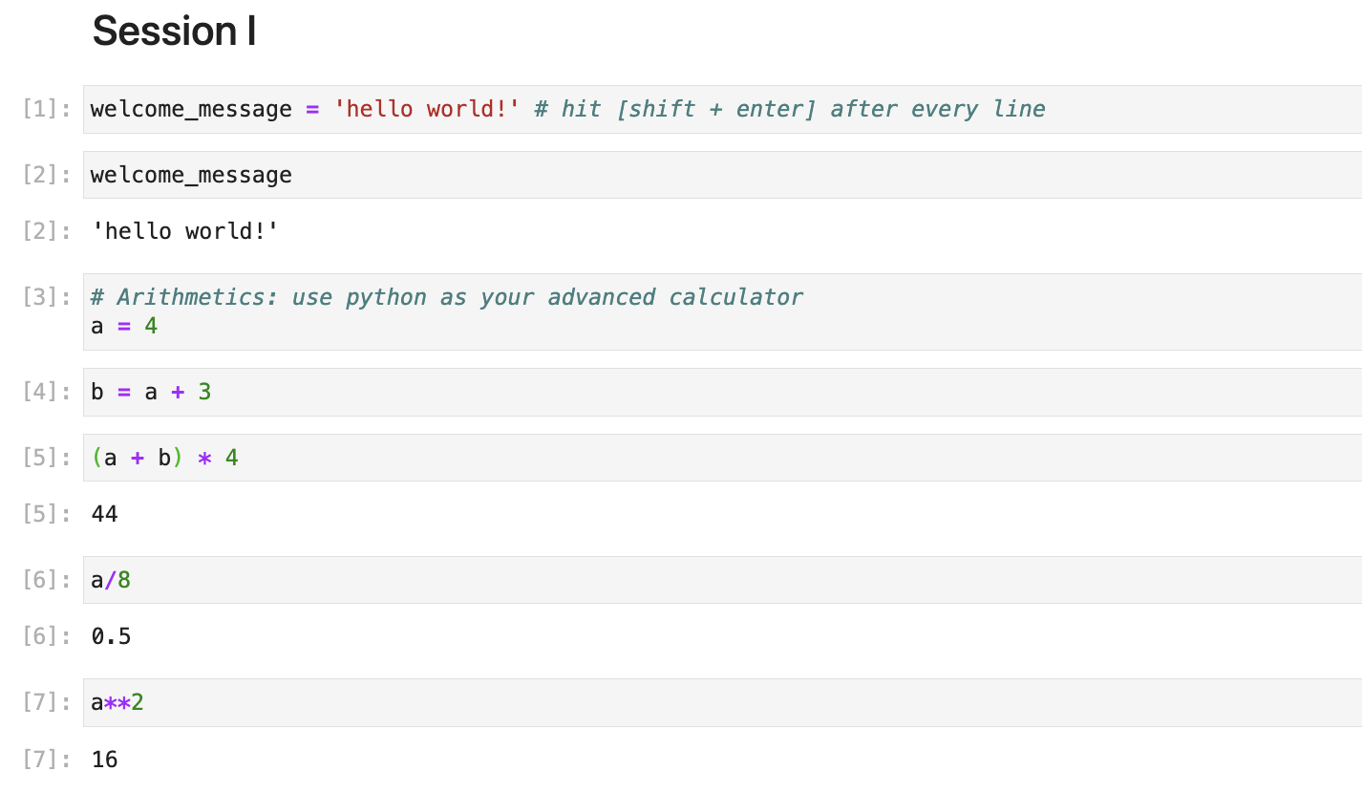
Discussion session I: Arithmetics

Slide 14
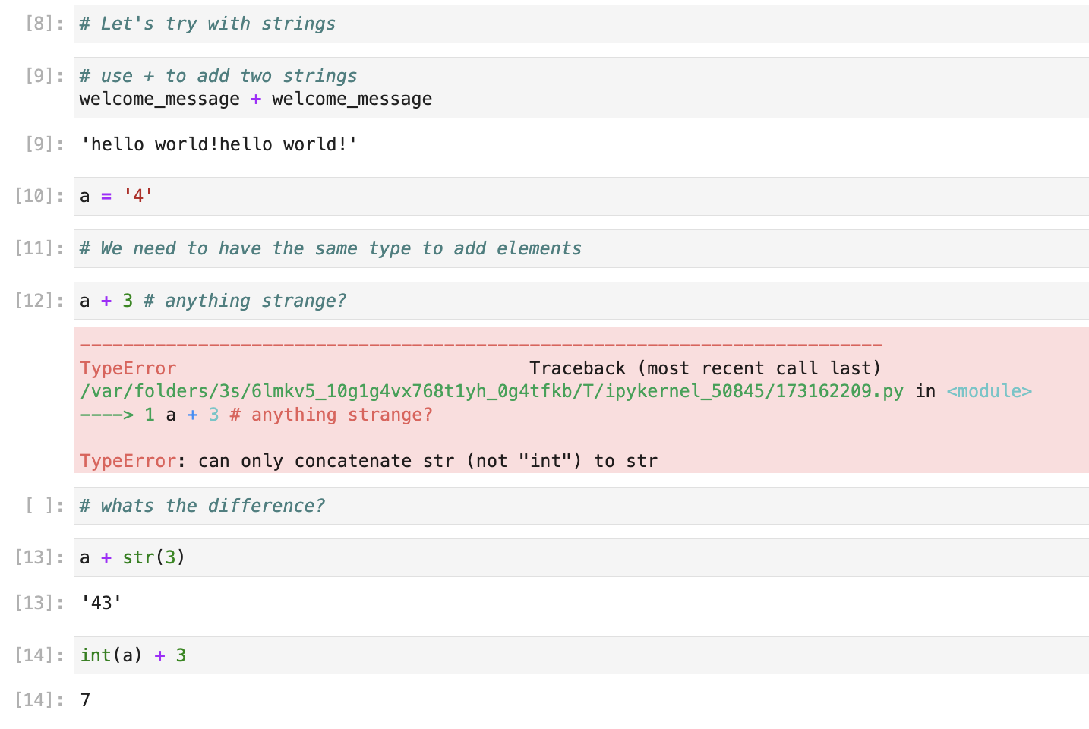
Discussion session I: Concatenation
Notes:
show live in file JupytherLab_introduction_showNotes in bio334_teaching

Slide 15
List data structure
like a shopping list we have an object that can store multiple objects at once.
it can hold different objects as well
every element has an index, starting from 0 which you can access with the square brackets [ ]
my_list = ['butter','milk','oranges']
my_list = ['butter',1,1.5,'milk']
>>> my_list[0]
'butter'

Slide 16
List data structure
get subset of a list (“slicing”)
assign new values to list elements
powerful list operations
e.g. append(), len(), sort(), reverse(), insert()
>>> my_list[0:2]
['butter','milk']
my_list[0] = 'bananas'

Slide 17
Session II: Work with lists
# create your first list # try accessing it with indices
my_list = [1,2,3,4,5]
my_list[1]
my_list[5]
my_list[0:3]
my_list[-1]
len(my_list)
# mixed lists:
# put different data types in your list
my_mixed_list = ['UZH','founded in',1934]
my_mixed_list[2] = 1834
del my_mixed_list[1]
my_mixed_list.append('A.D.')
my_mixed_list
# apply arithmetic operators on lists
[1,2,3] + [3,4,6] # list concatenation
['Hello'] * 4

Slide 18
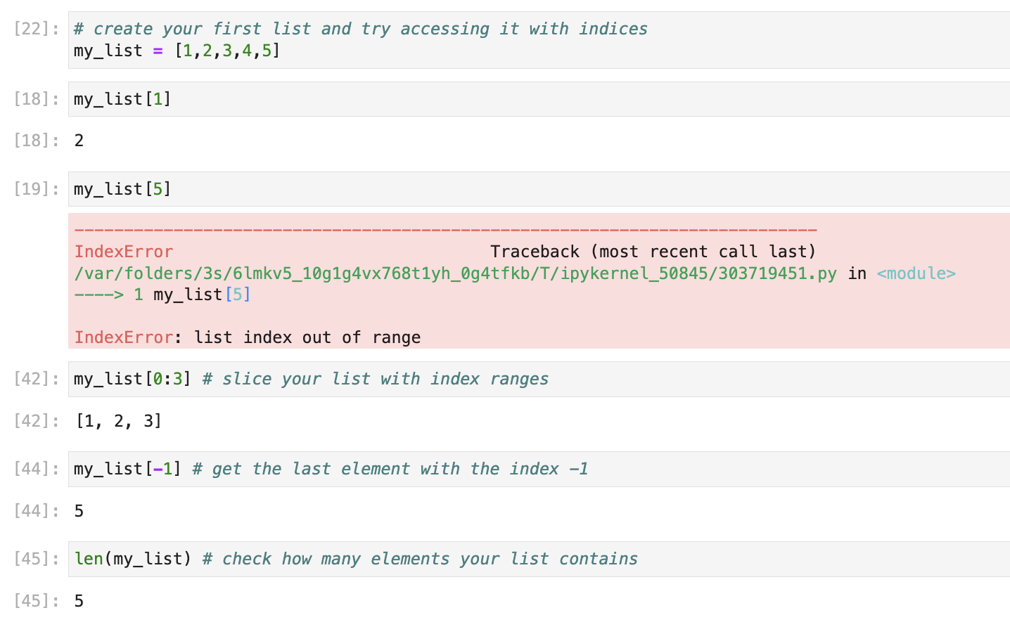
Discussion session II: Accessing list elements

Slide 19
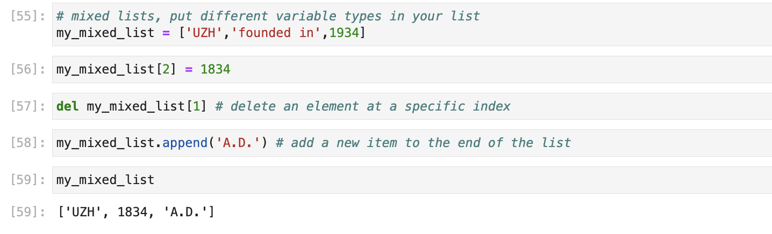
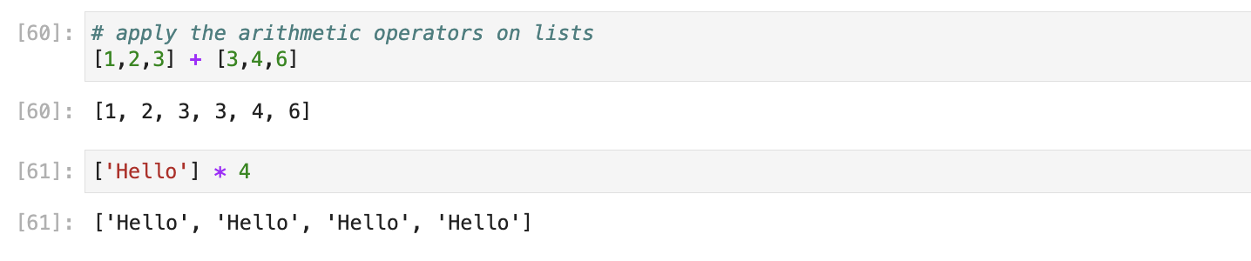
Discussion session II: List modifications and arithmetic operations on lists

Slide 20
Strings & Lists
Strings can also be considered lists of characters and can be accessed by index
To convert them to an actual list (and make them mutable) use list()
While this opens many possibilities, check the cheat-sheet for convenient built-in string operations
e.g. split(), join(), replace()
>>> my_sequence = 'MRHIAHTQRCLSR'
>>> list(my_sequence)
['M', 'R', 'H', 'I', 'A', 'H', 'T', 'Q', 'R', 'C', 'L', 'S', 'R']

Slide 21
Dictionaries
Similar to lists, but elements are accessed through a user defined key
retrieve their value by using the key
my_proteins_seqs = {}
my_proteins_seqs = dict() # same as above
my_proteins_seqs['DROME_HH_Q02936'] = 'MRHIAHTQRCLSRLTSLVA'
my_proteins_seqs['DROME_PATC_P18502'] = 'MDRDSLPRVPDTHGDVVD'
>>> my_proteins_seqs['DROME_HH_Q02936']
'MRHIAHTQRCLSRLTSLVA'

Slide 22
Session III: Strings and dictionaries
# Try accessing a string like a list
my_string = 'hello world!'
my_string[6]
my_string[-1] = '?'
my_list = list(my_string)
my_list[-1] = '?'
my_modified_string = ''.join(my_list)
my_modified_string
# create your first dictionary
dna_to_rna = {}
dna_to_rna['A'] = 'A'
dna_to_rna['T'] = 'U'
dna_to_rna['C'] = 'C'
dna_to_rna['G'] = 'G'
dna_to_rna
#or in one line
dna_to_rna = {'A':'A','T':'U','C':'C','G':'G'}
#dictionary operations
dna_to_rna['U']
'U' in dna_to_rna
dna_to_rna.keys()
dna_to_rna + dna_to_rna

Slide 23
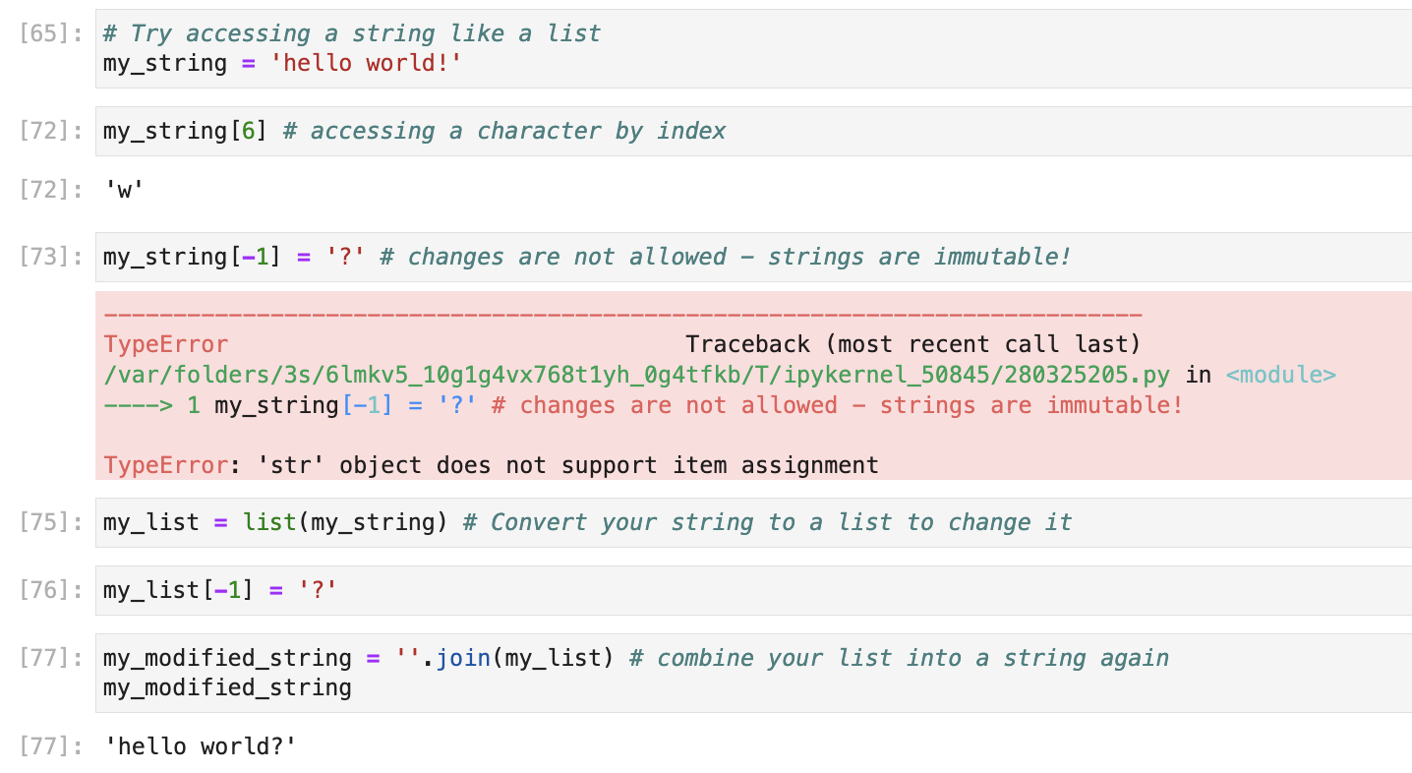
Discussion session III: String lists

Slide 24
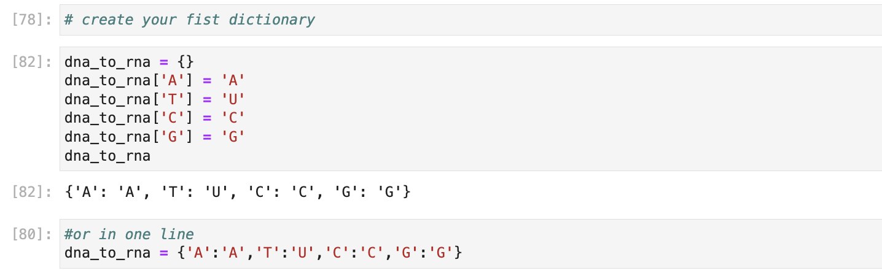
Discussion session III: Dictionary definition

Slide 25
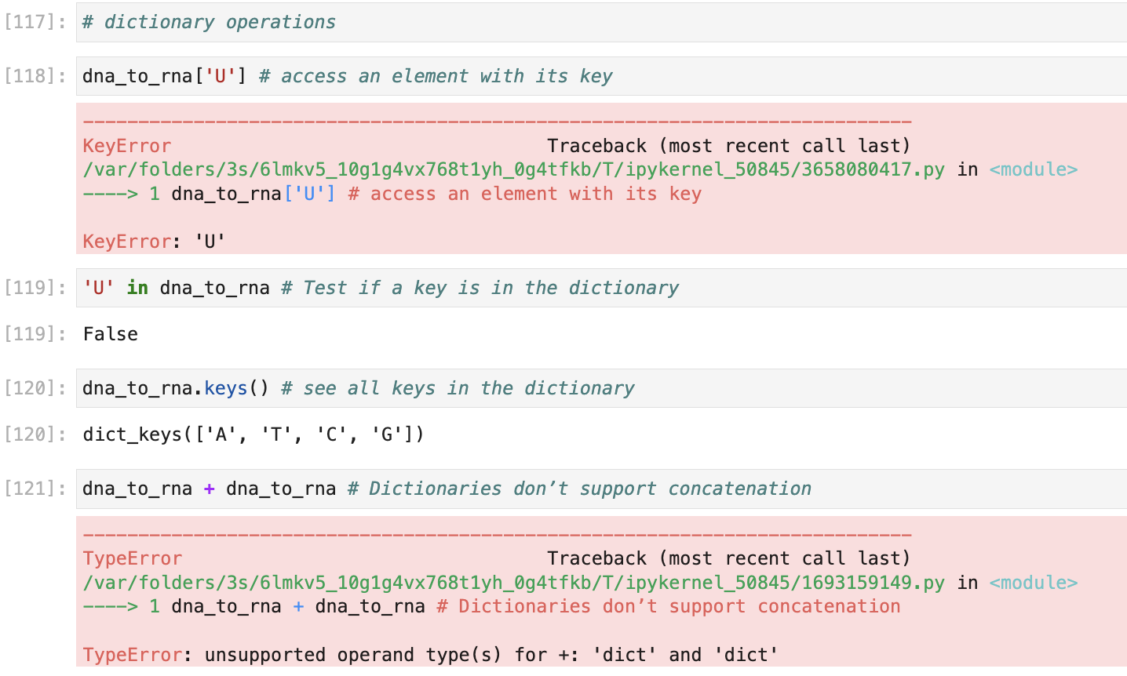
Discussion session III: Dictionary usage

Slide 26
Functions
function: stores instructions (not values)
basic use: function_name(arguments)
many functions loaded by default in python, e.g.
str() - convert an object into a string
int() - convert an object into an integer
float() - convert a object into a floating point number
type() - tells you the type of an object
see many others in the cheat-sheet and find them on https://docs.python.org/3/library/functions.html

Slide 27
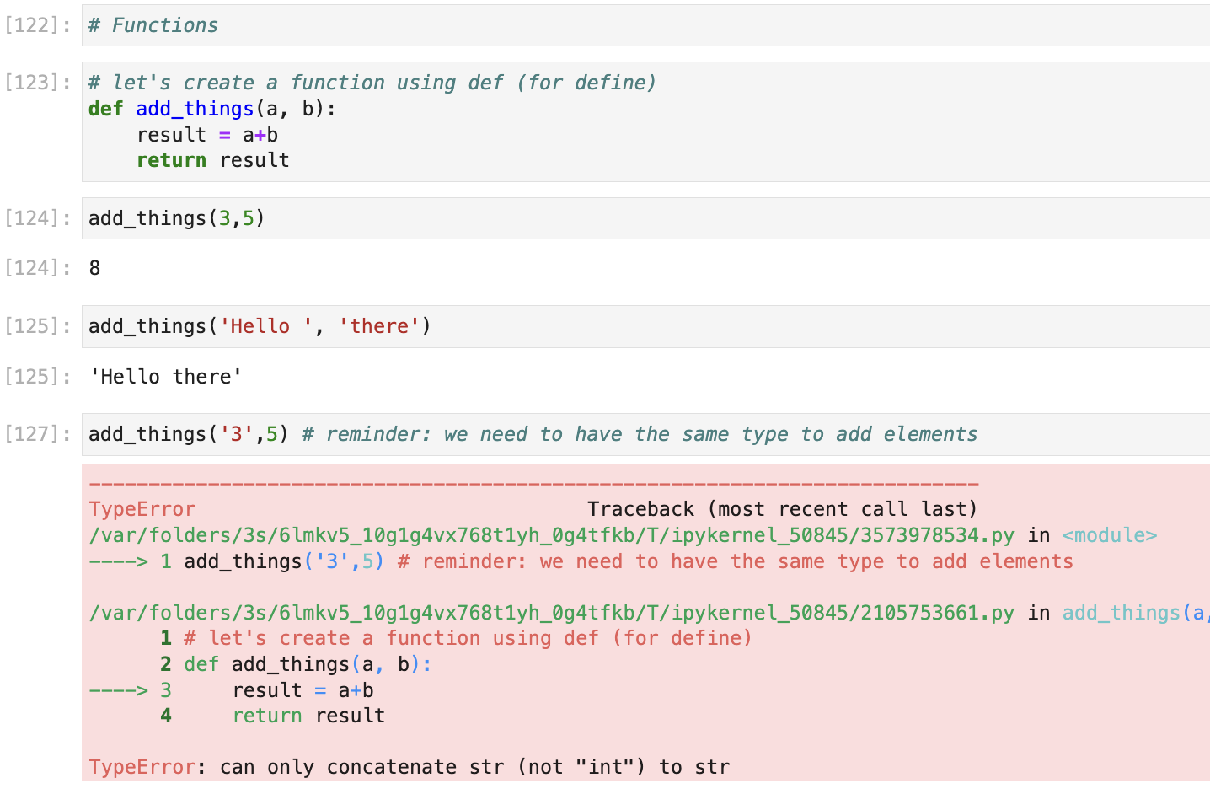
Function example

Slide 28
Methods
functions of a specific object class
access by <variable_name>.<method>(arguments)
in iPython: write . after a variable name and press <tab> to get an overview about available methods
alternatively: dir(object)
use ? / ?? (in ipython) or help() to get information about a method and its arguments e.g. ?my_str.split or help(my_str.split)
alternatively: google or ask chatGTP
>>> s = 'The quick brown fox jumps over the lazy dog'
>>> s.split()
['The', 'quick', 'brown', 'fox', 'jumps', 'over', 'the', 'lazy', ‘dog']
>>> s.split('fox')
[‘The quick brown ‘, ‘ jumps over the lazy dog']

Slide 29
Break

Slide 30
Part 2:
Writing Python code

Slide 31
Why write a script?
Organize your commands in a text file and build more complicated workflows that can be executed at once.
save typing, make your work reproducible
Run it at any point by executing your script
Use comments (#) to describe your code
use the print() function to print the output or an intermediate result
>>> print(“Hello”,”Python!”)
Hello Python!

Slide 32
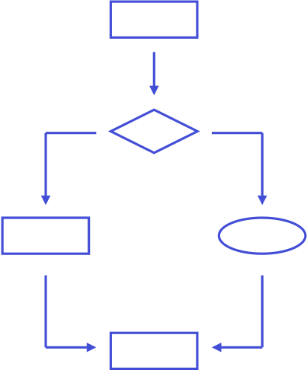
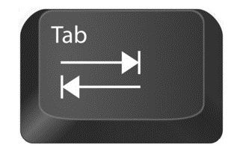
Conditional statements
Use if/else clauses to make decisions
Remember the indentation!
While other programming languages use brackets or end statements, Python uses whitespace to structure code.
Simply use tabulator to indent.
if boolean_expression:
print(“The statement is True”)
else:
print(“The statement is False”)

Slide 33
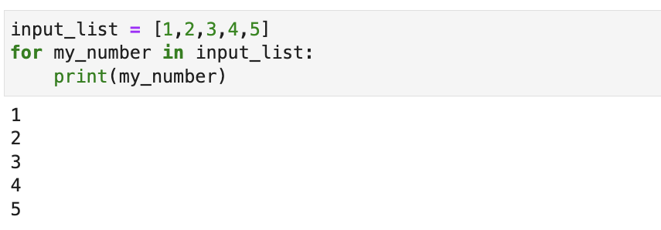
Loops
Loops are essential for repeating an action several times
The for loop executes the nested statements as many times as there are elements in the input list.

Slide 34
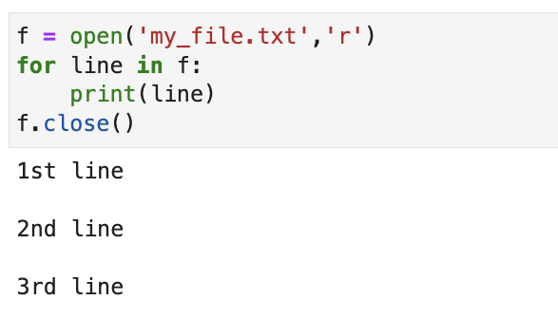

for loop for reading text files
File: my_file.txt
1st line
2nd line
3rd line
EOF

Slide 35
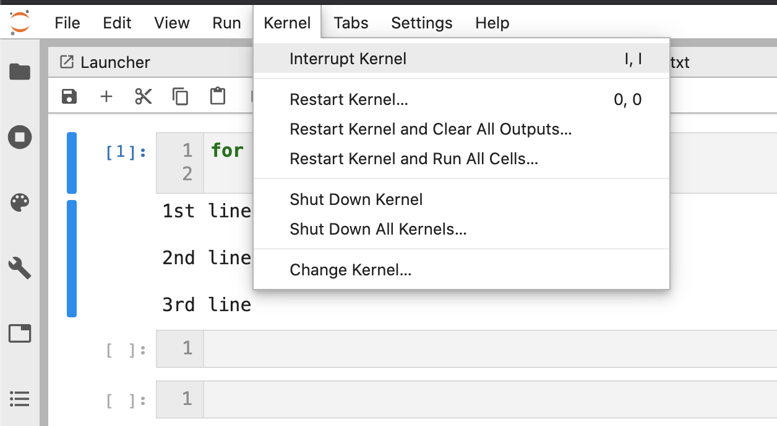
Conditional loop
Use the while loop to continue an action until a condition is not satisfied anymore
>>> number_apples = 3
>>> while number_apples > 0:
... number_apples -= 1
... print(“Ate an apple,”,number_apples,'left')
...
Ate an apple, 2 left
Ate an apple, 1 left
Ate an apple, 0 left
in case you need to terminate your loop…

Slide 36
Session IV: Loops and friends
# 1. try out this for loop
for my_number in range(6):
print(my_number)
# 2. A new loop key-word: continue
for my_number in range(6):
if my_number == 3:
continue
print(my_number)
print('after loop: ‘, my_number)
# 3. try using break instead of continue
# 4. when will this while loop finish?
my_number = 1
from time import sleep
while my_number < 5:
print("hurray! my number is increasing:", my_number)
sleep(1)
in case you need to terminate your loop…

Slide 37
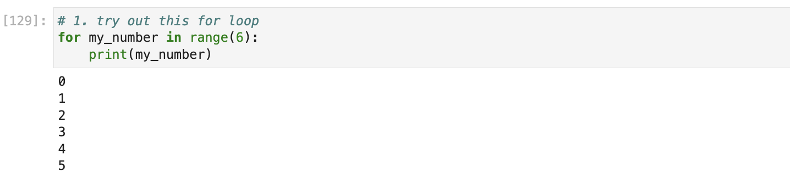
Discussion session IV: Loops and friends

Slide 38
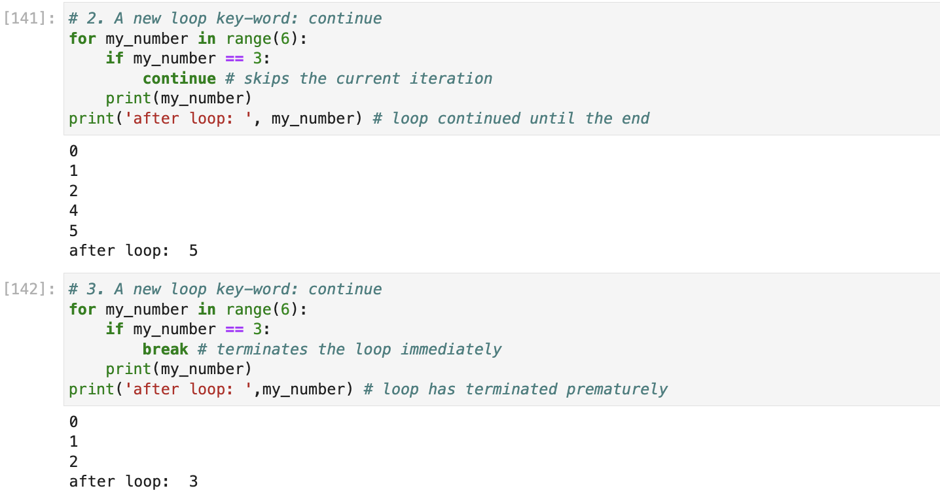
Discussion session IV: Loops and friends

Slide 39
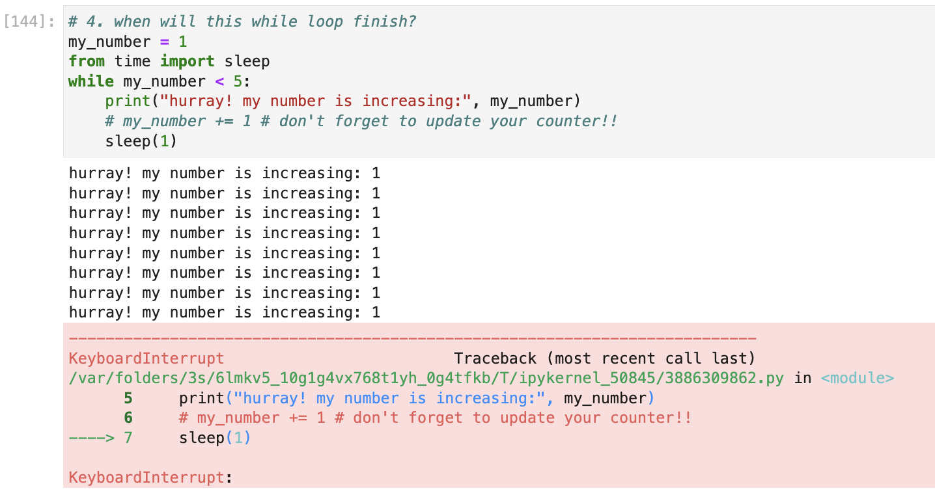
Discussion session IV: Loops and friends

Slide 40
python modules

Slide 41
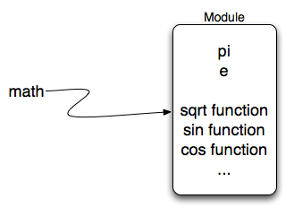
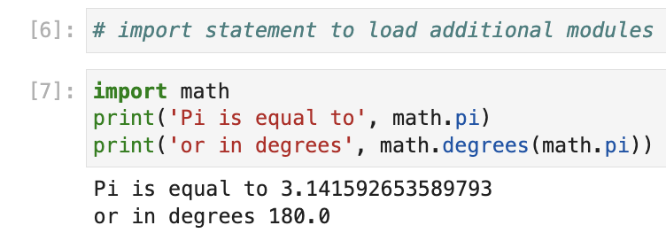
Import statement
Use import to load additional modules for more functionalities
For example the math module:
more details at: https://docs.python.org/3/library/math.html

Slide 42
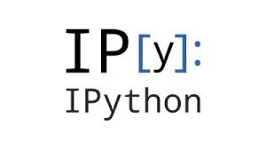


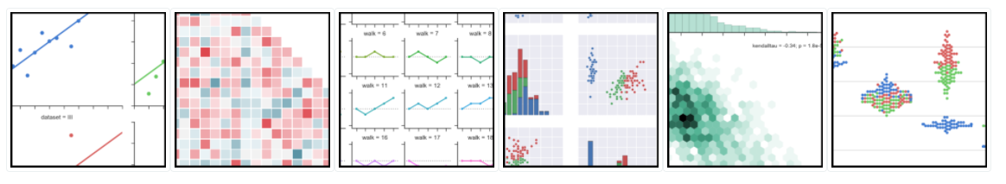
Much more to discover
ipython magics make your life a lot easier
time your code, debug it, call other languages
make python lightning fast using numpy, scipy, and cython/pypy/numba
visualize your data with seaborn, bokeh and matplotlib

Slide 43
Further reading
https://snakify.org/ (interactive tutorial)
http://www.diveintopython.net/(comprehensive, general purpose)
http://swcarpentry.github.io/python-novice-inflammation/ (scientific python by example)
http://www.scipy-lectures.org/intro/intro.html (intro by the scientific python consortium)
https://github.com/dblyon/pandasintro (extensive introduction to pandas)
https://cs50.harvard.edu/college/2021/spring/weeks/0/

Slide 44
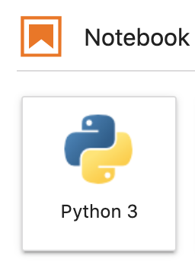
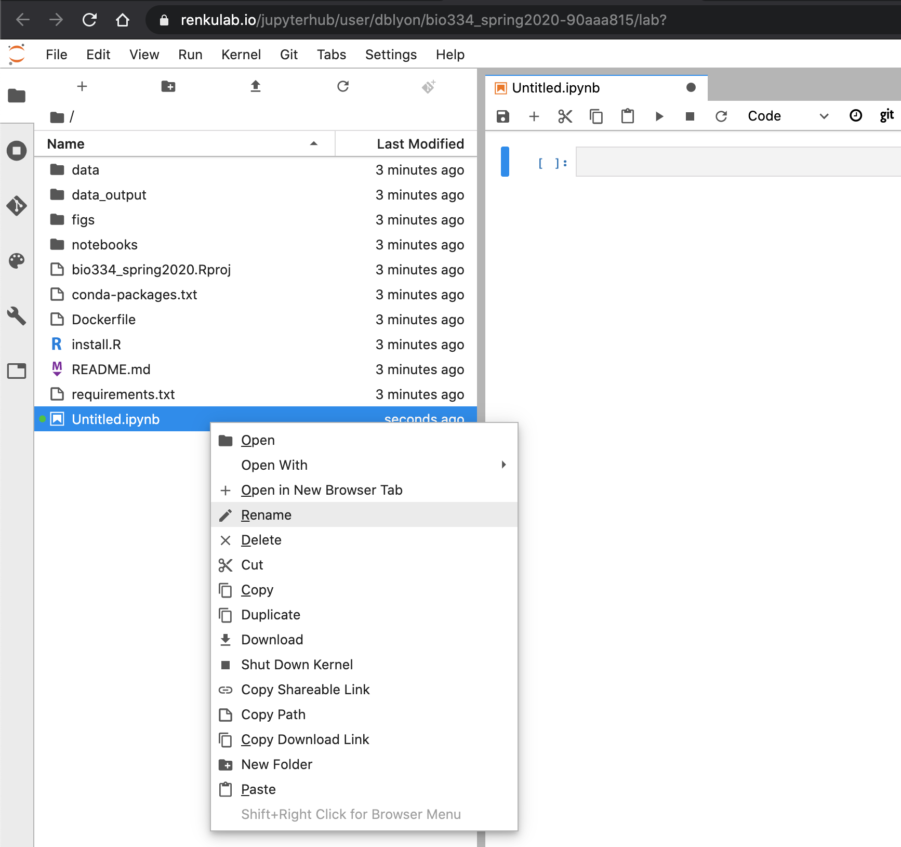
Exercise session
Create a new Python3 Jupyter Notebook, save it to the folder /Bio334/02_python_introduction/exercises and start exploring
Change the name of your newly created file by right clicking on Untitled.ipynb
To execute a cell press Shift + Enter

Slide 45
optional exercise slides follow

Slide 46
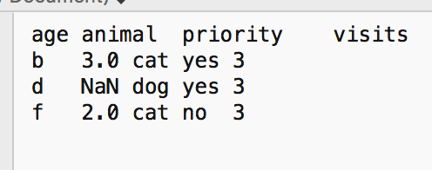
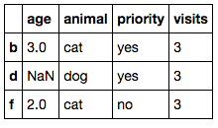
Optional Exercise #3
Learn the basics of Pandas, a powerful python module for data analysis, including reading, writing, filtering, merging, arithmetic operations on and sorting of tabular data

Slide 47
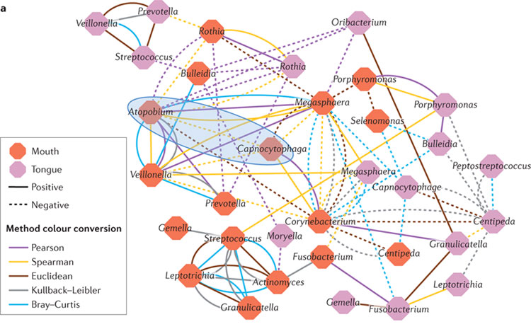

Optional Exercise #4
Create a pipeline to infer simple ecological relationships in the Human Microbiome

Slide 48
Optional exercise session
Create a new python file in JupyterLab
To execute, launch a terminal tab and enter
ipython <script_name>.py
Good luck!

Slide 49

sys module
A built-in module that contains system-specific parameters and functions
For example we can use it to read arguments from the command line:
Script: say_hello.py
import sys
print(‘Hello there', sys.argv[1])
# Command line arguments are in sys.argv[1], sys.argv[2]...
# sys.argv[0] is the script name itself
davide$ python say_hello.py bio334_Students
Hello there bio334_Students

Slide 50
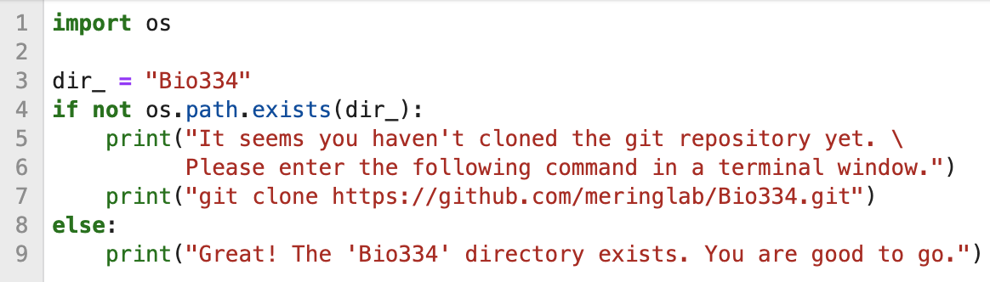
os module
Another built-in module that contains miscellaneous operating system interfaces
For example we can use it to obtain the name of the user currently logged in:
Script: check_directory.py
Run the script in a terminal window

